Slide 1
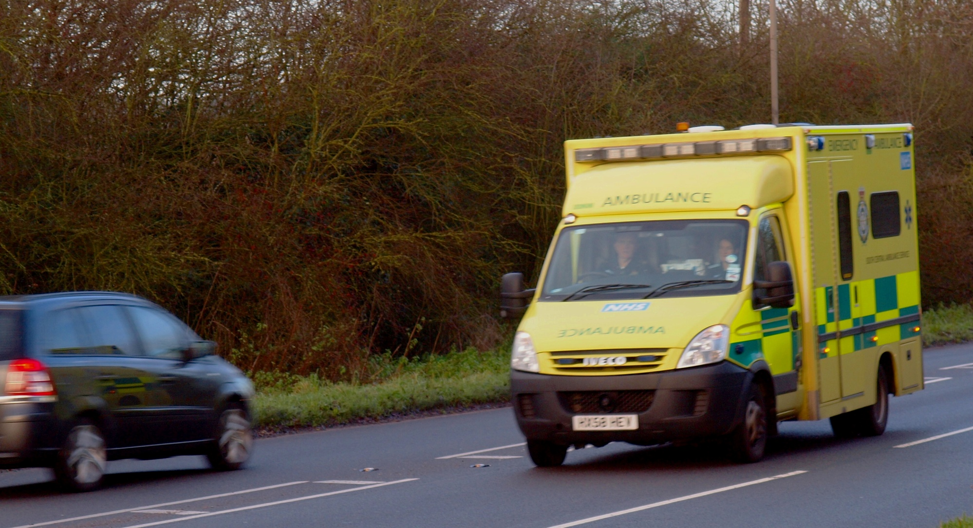
Roads in the AONB
Notes:
Vn 1.0 3-Jan-2015
Slide Subject
2,3 A413
4,5 Rocky Lane
6,7 Bowood Lane
8,9 Leather Lane
10,11 Potter Row
12-15 South Heath
16,17 Frith Hill
18,19 B485
20,21 Hyde Lane
22,23 Hyde Heath Road
24 S.Heath – N.Portal access
25,26 Chilterns Tunnel – N Portal Access
ToDo – Spoil Dump ?

Slide 2
Contents
Vn 1.0 3-Jan-2015
Slide Subject
3,4 A413
5,6 Rocky Lane
7,8 Bowood Lane
9,10 Leather Lane
11,12 Potter Row
13-16 South Heath
17,18 Frith Hill
19,20 B485
21,22 Hyde Lane
23,24 Hyde Heath Road
25 S.Heath – N.Portal access
26,27 Chilterns Tunnel – N Portal Access
To Do
Spoil Dump, Hunts Green ?

Slide 3
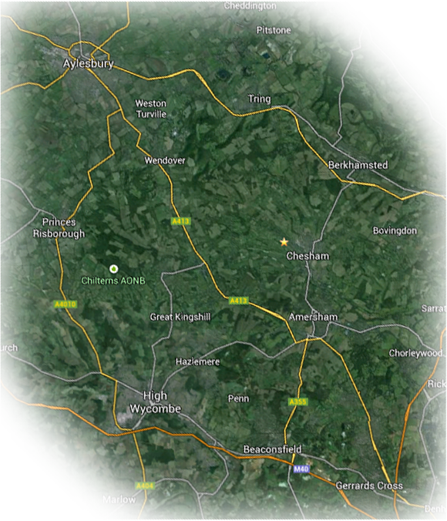
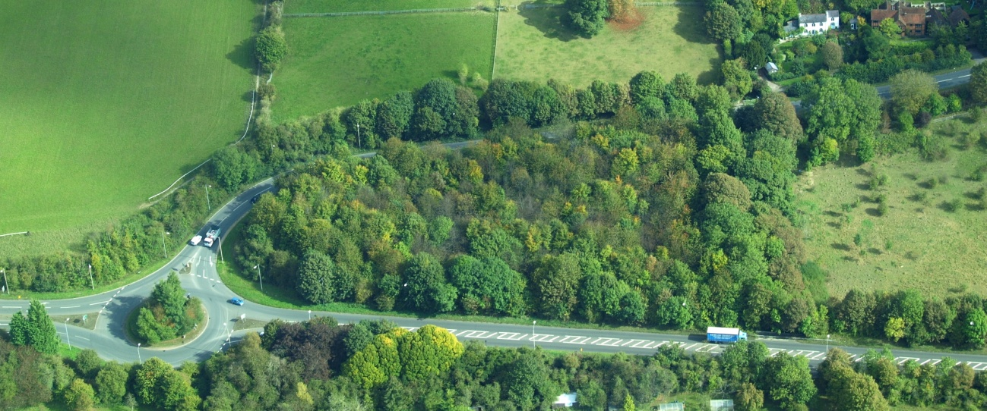
The A413
The A413 is the main road through the
Misbourne Valley, carrying commuter
traffic from Aylesbury Vale to the M25
and M40 at Gerrards Cross.
It is also the route used by ambulances
accessing the A&E department at Stoke
Mandeville
HS2 Ltd propose that it carry all
construction traffic to and from the
compounds in the AONB.

Slide 4
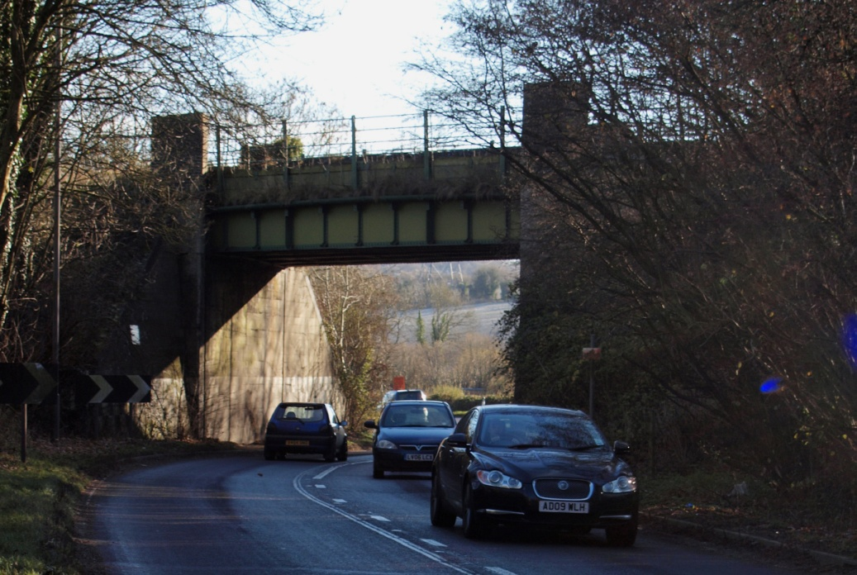
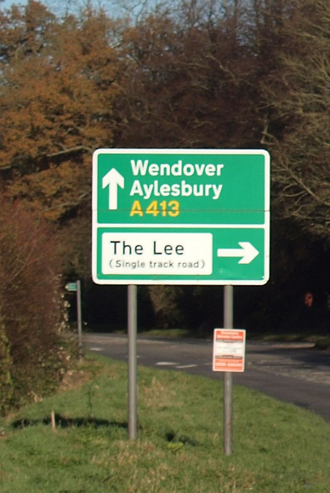
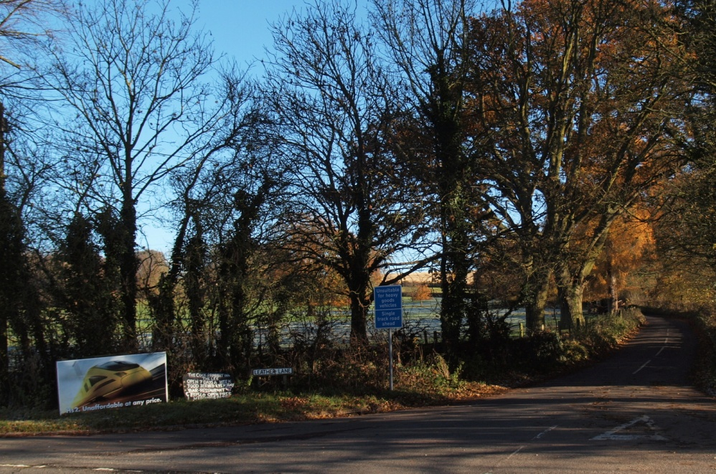
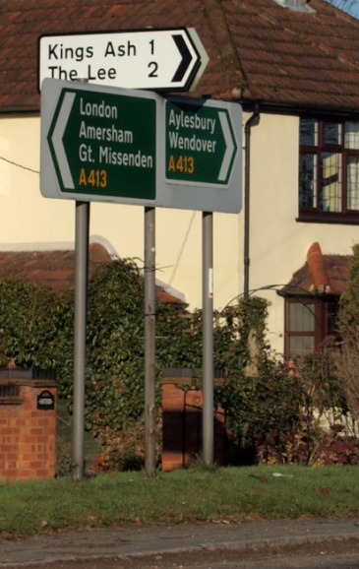
The A413
The A413 also links the network of
narrow lanes, characteristic of the
Chilterns.
Much of the road is narrow, and the
Deep Mill rail bridge is a known hazard.

Slide 5
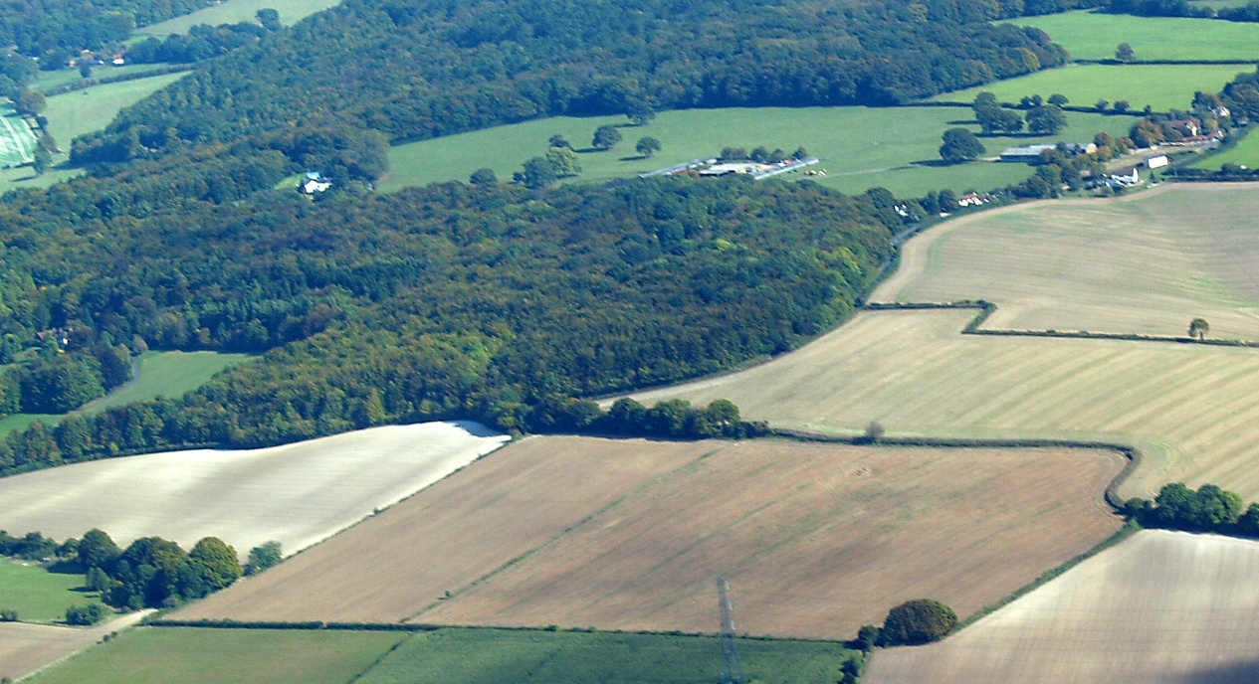
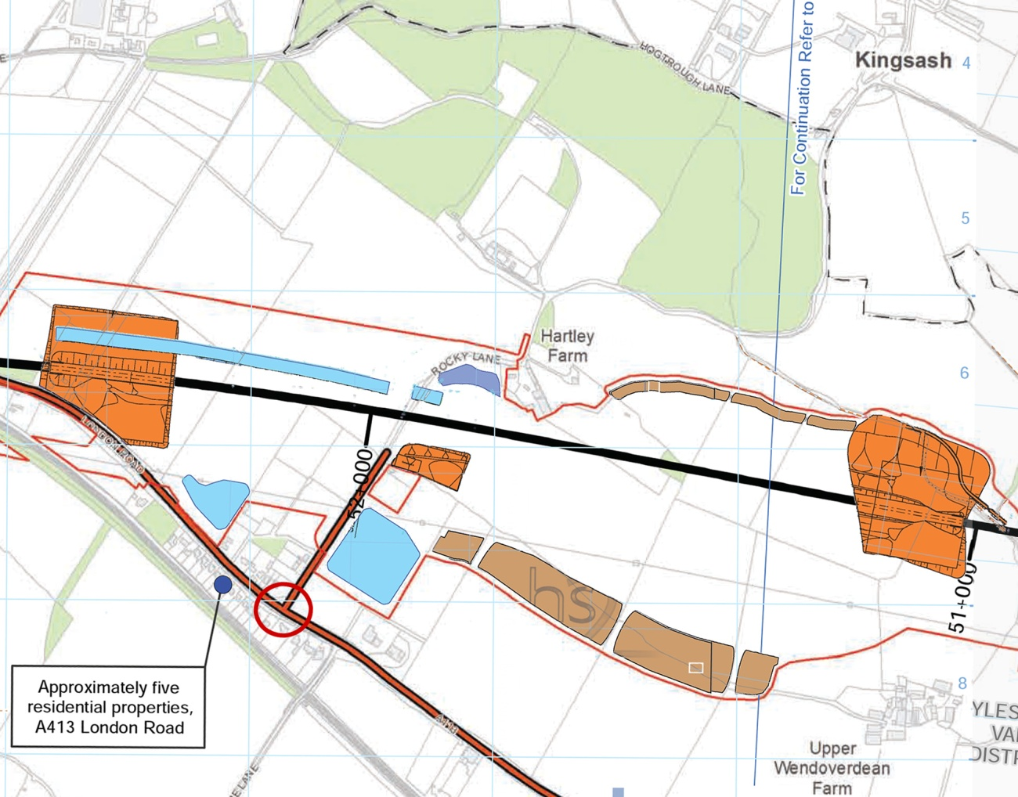
Rocky Lane
Rocky Lane is the first lane
on the left after the roundabout
at the southern end of the
Wendover Bypass ..
It lies between the Smalldean
and Wendover Dean Compounds,
and is the access route to a
smaller compound which will be
used to construct a new
underbridge.

Slide 6
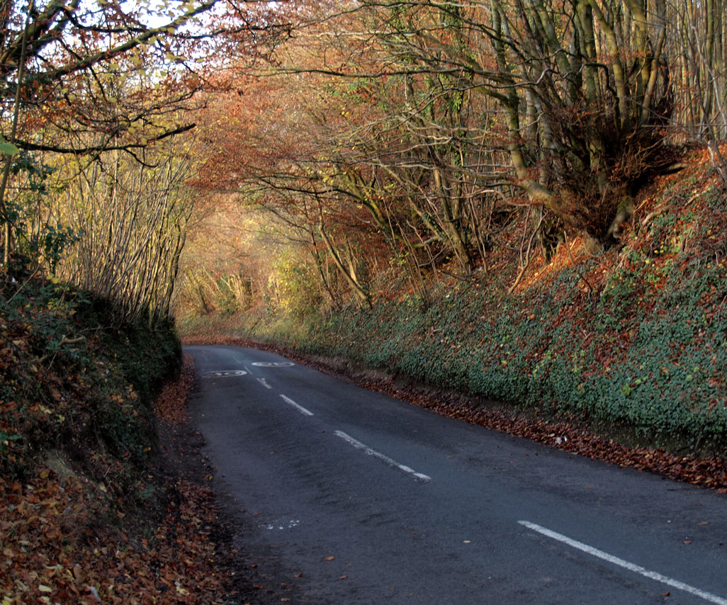
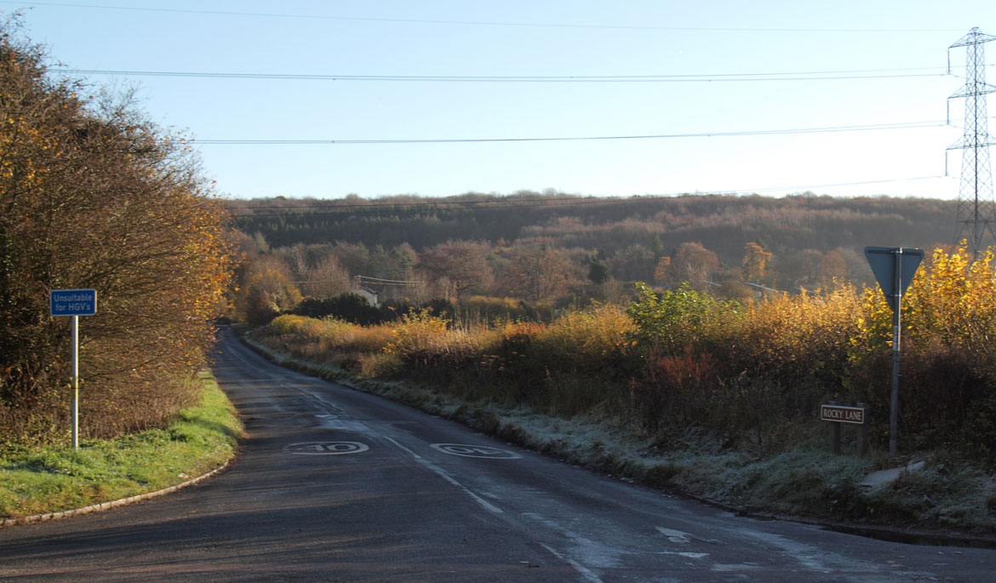
Rocky Lane
Between the A413 and Kings Ash, this
is a steep, narrow sunken lane.
It continues to Chesham via Swan
Bottom and Chartridge, and is the main
access road towards Wendover from
The Lee.
Increased congestion
on the A413 is likely to
result in a significant
increase in traffic using
Rocky Lane, despite it
being unsuitable as a
diversion.
This will further increase
congestion at the junction
of Chartridge Lane and
St Mary’s Way in Chesham
Turning right onto the A413 can lead to long delays, during peak hours

Slide 7
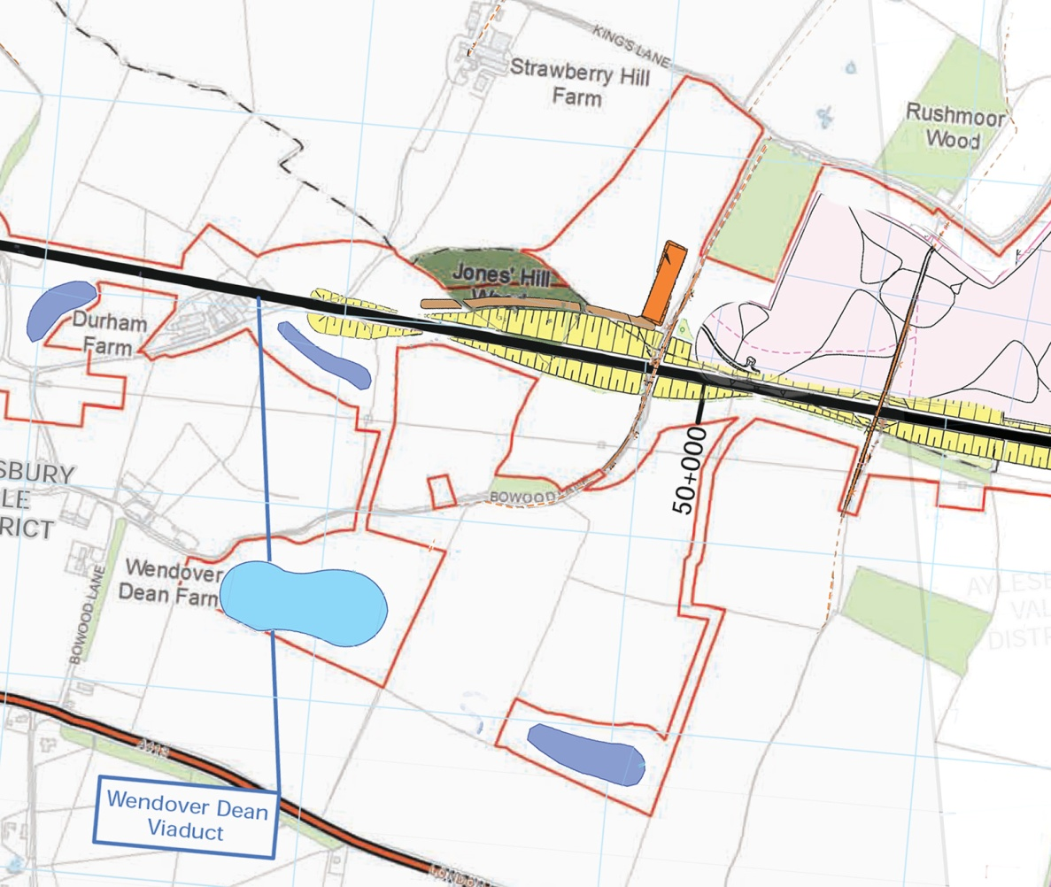
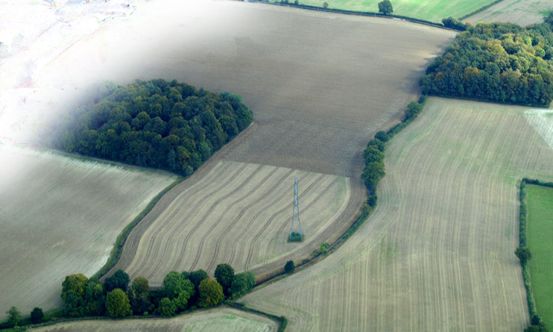
Bowood Lane
Bowood Lane runs between
the A413 and Kings Lane.
The compound (for the
construction of a new overbridge)
is accessed along the trace.
Jones’ Hill (Ancient) wood is to
the left, and the proposed spoil
dump to the right of the Lane.

Slide 8
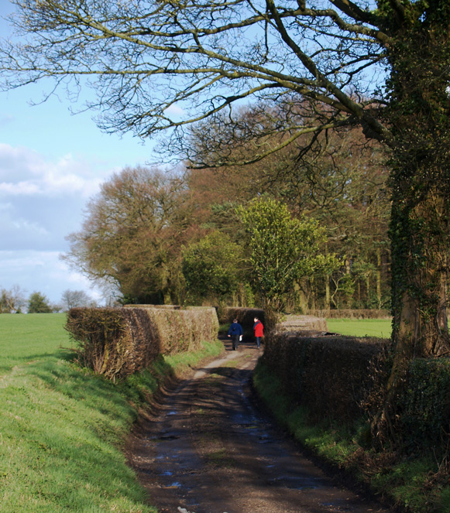
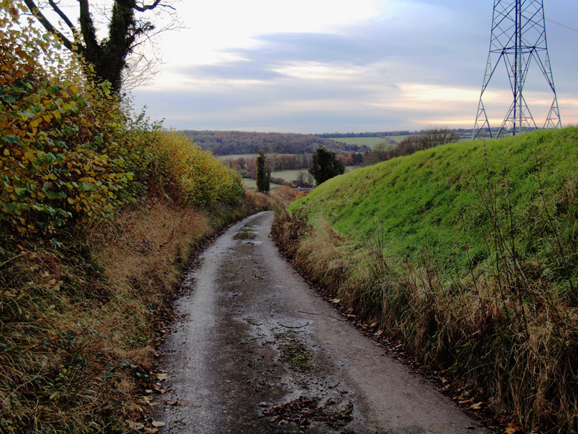
Bowood Lane
Above Wendover Dean Farm, the
Lane is almost free of traffic, but
much used by Walkers and Cyclists.
Any additional traffic would complete
the destruction resulting from the new
bridge, cuttings and adjacent spoil heap.

Slide 9
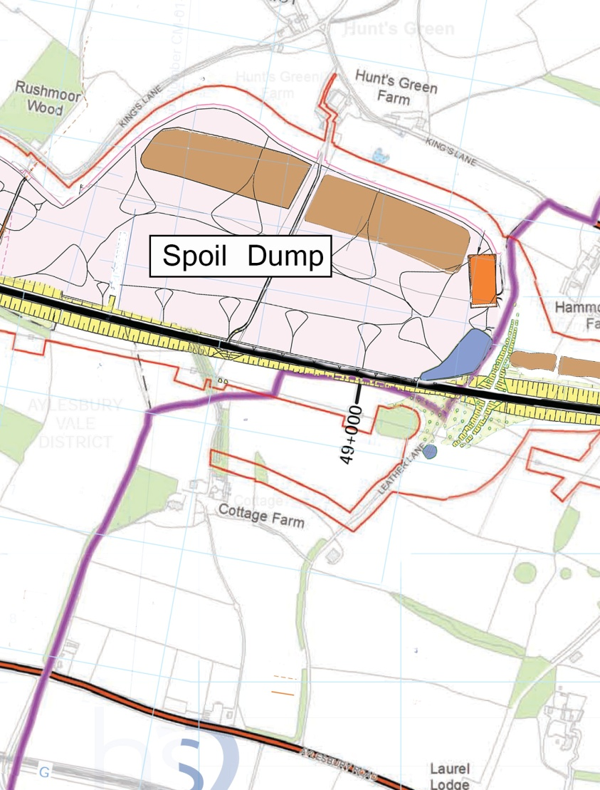
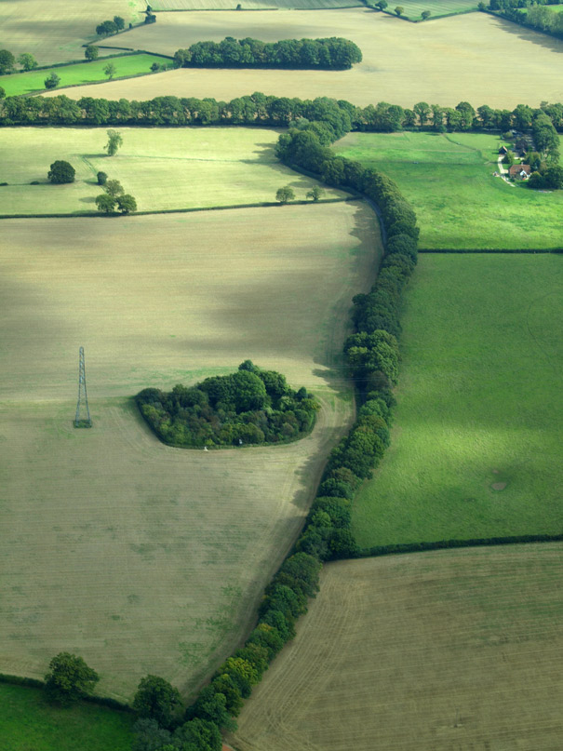
Leather Lane
Leather Lane is another sunken lane connecting the A413 and Kings Lane. It carries
a significant amount of traffic, despite being single track on the steepest section.
The siting of the new overbridge will cause an unnecessary loss of hedgerow on the
SE side, while the NW side is dominated by the proposed spoil dump.

Slide 10
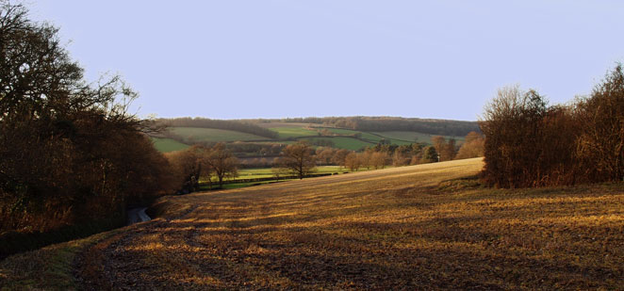
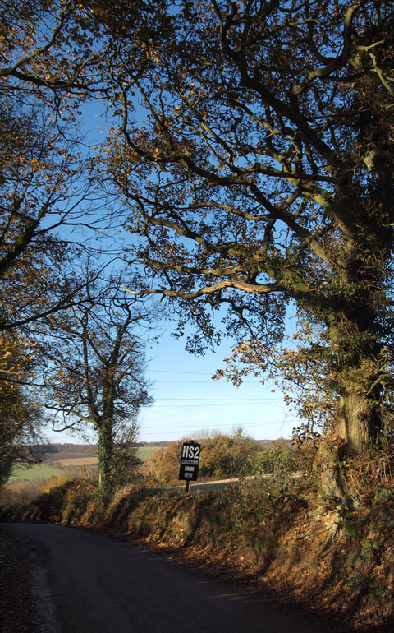
Leather Lane
There is ample room between the lane and the
old chalk pit for an offline overbridge to be built
to the NW of the existing alignment, allowing the
trees on the other side to be retained as a screen
for the spoil dump.
Any increase in traffic will cause congestion and
damage to the banks and hedgerows bordering
the lane.

Slide 11
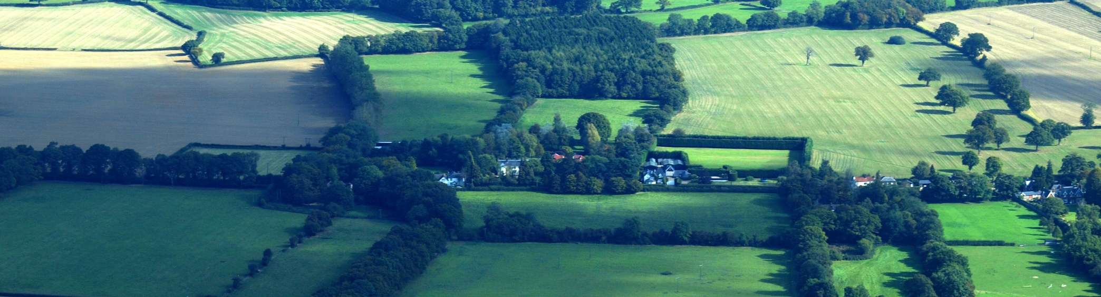
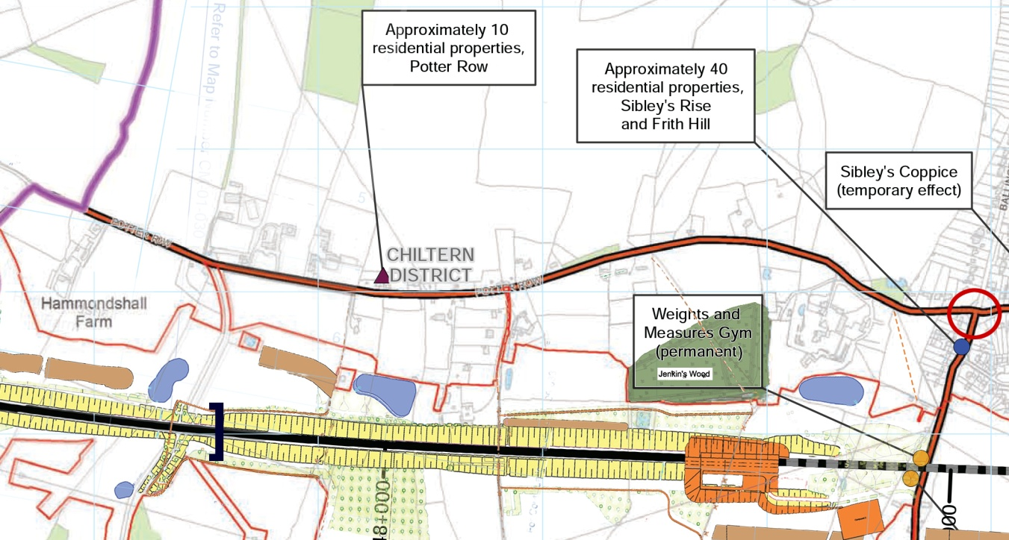
Potter Row
Potter Row is a residential
street, a few hundred metres
from the proposed line.
Construction traffic from the
Leather and Bowood Lane
compounds is routed along
Potter Row, adding to the
disturbance caused by the
excavations for the cuttings
and South Heath tunnel

Slide 12
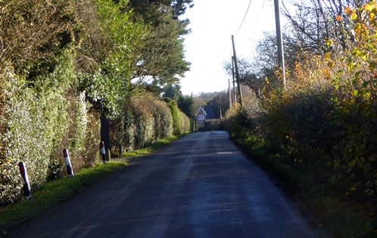
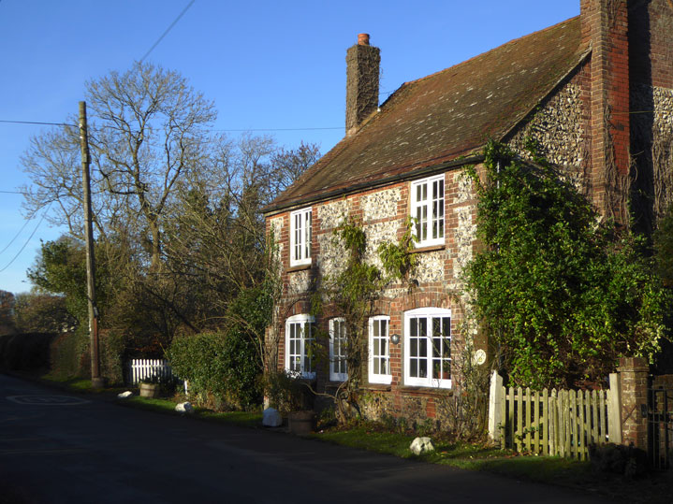
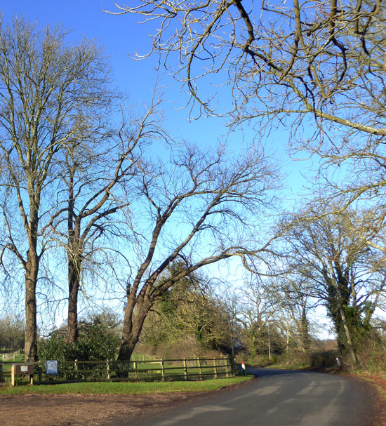
Potter Row
Potter Row is a narrow lane, without
footpaths. Several properties are
immediately adjacent to the carriageway,
and may not survive the impact of heavy
construction traffic.

Slide 13
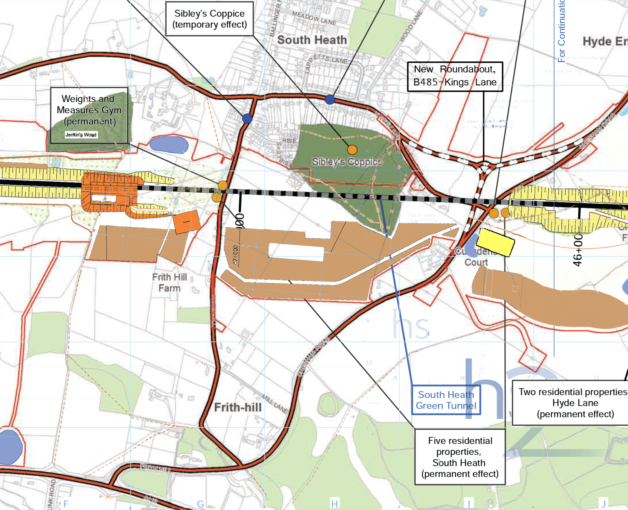
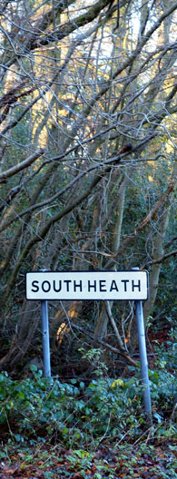
South Heath
ES Vol 2 5.4.31 - “Residents of South Heath are predicted to experience a combination of residential and community infrastructure demolitions, changes to residential amenity in places throughout the village, temporary (?) loss of land at Sibley’s Coppice and the minor (?) adverse temporary isolation effects from facilities in Great Missenden. This is considered to have a community wide effect on the community of South Heath.”

Slide 14
Access as proposed by HS2
Chilterns Tunnel
portal
Bowood & Leather Lanes
South Heath
‘green’ tunnel
Little Miss
Vent Shaft
Hyde Heath Road
Potter Row
30
Kings La
30
HS2 TRACE
35
HS2
55
35
HS2 .
55
Frith Hill
210
B485
A413
155
Little Missenden
155
HGV trips per day
in each direction
Deep Mill
bridge
Great Missenden

Slide 15
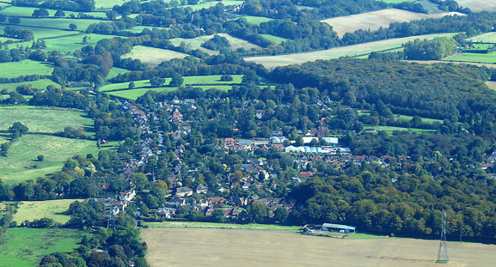
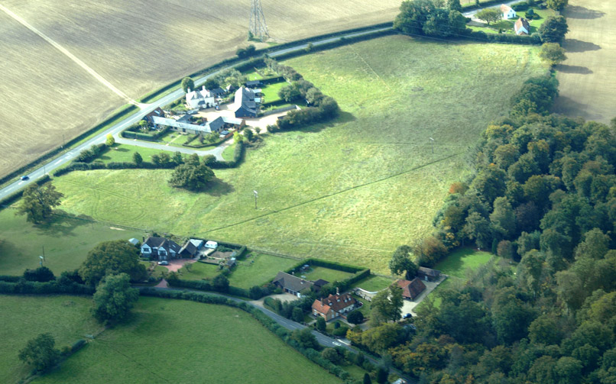
South Heath
View towards Ballinger;
Sibleys' Rise & Coppice in
the foreground →
← Kings Lane, Cudsden Court and the B485

Slide 16
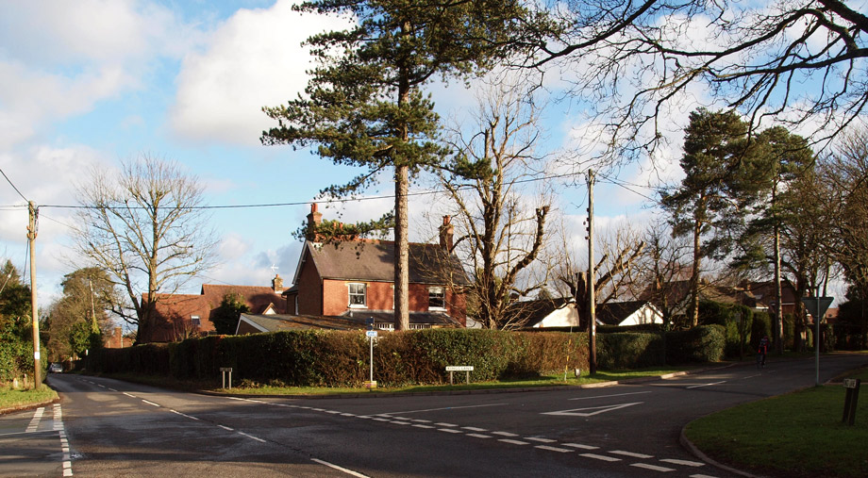
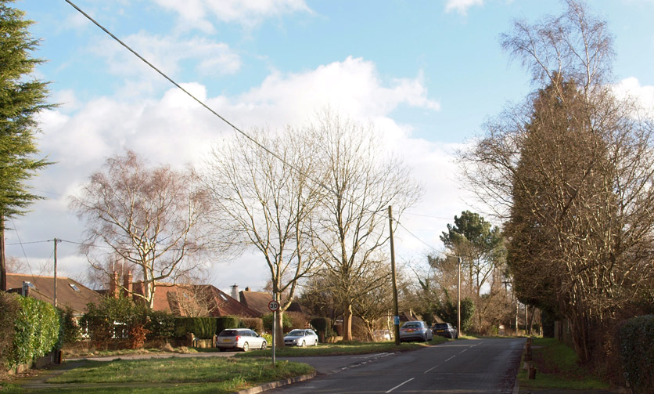
South Heath
Junction of Potter Row, Kings
Lane and Ballinger Road; used
by construction traffic from
Leather & Bowood Lane
compounds →
← Kings Lane, view towards
the B485

Slide 17
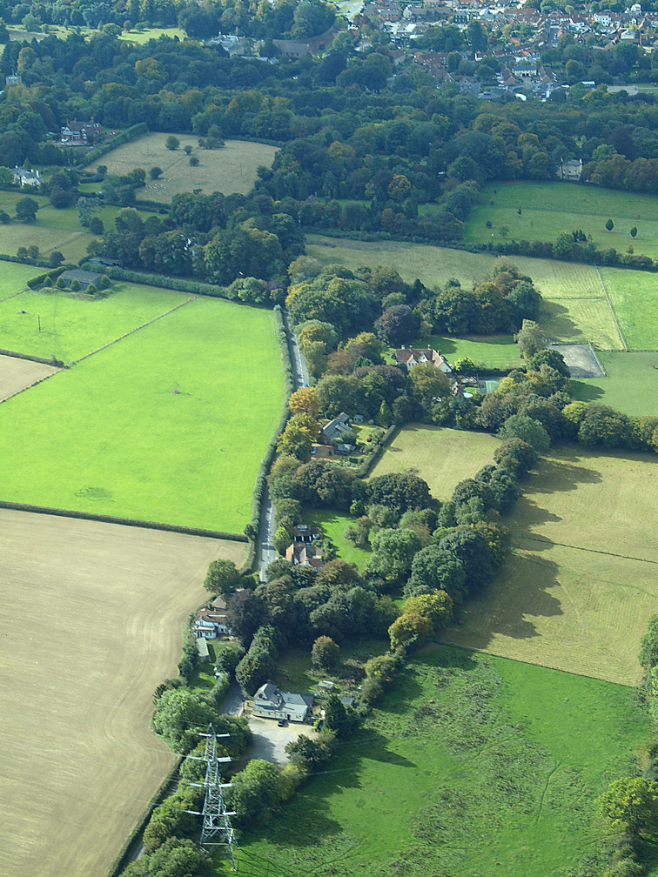
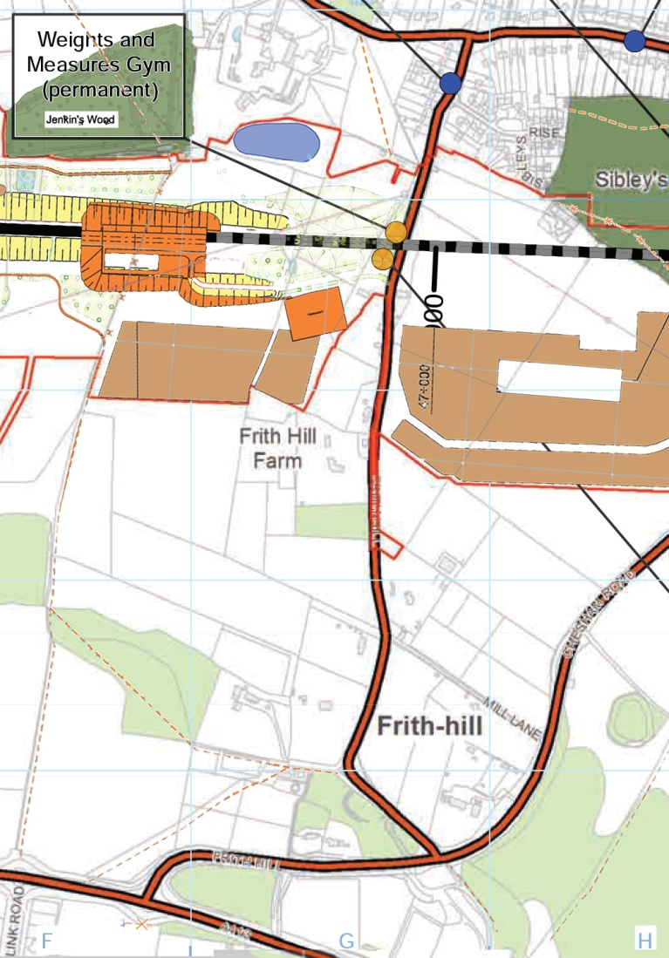
Frith Hill
View from South Heath towards Gt. Missenden, with “Weights and Measures” Gym
in the foreground. The road will be closed for two years during construction of the
‘Green’ tunnel, forcing National Cycle Route 57 to be diverted along the B485 (a
construction route)

Slide 18
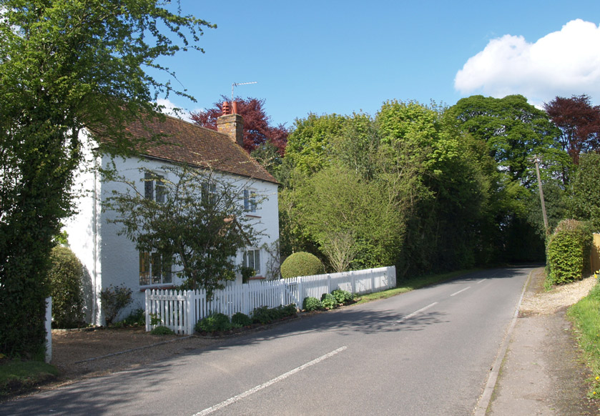
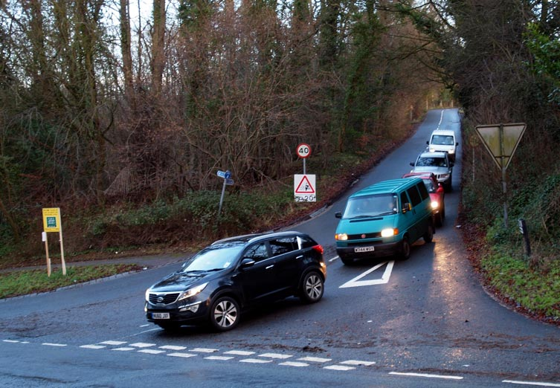
Frith Hill
← Property bordering on the
construction Zone of the
‘Green’ tunnel
The junction with the B485 is →
steep and a sharp turn, causing
problems for HGVs.
(HS2 proposed access route to
S. Heath tunnel North portal)

Slide 19
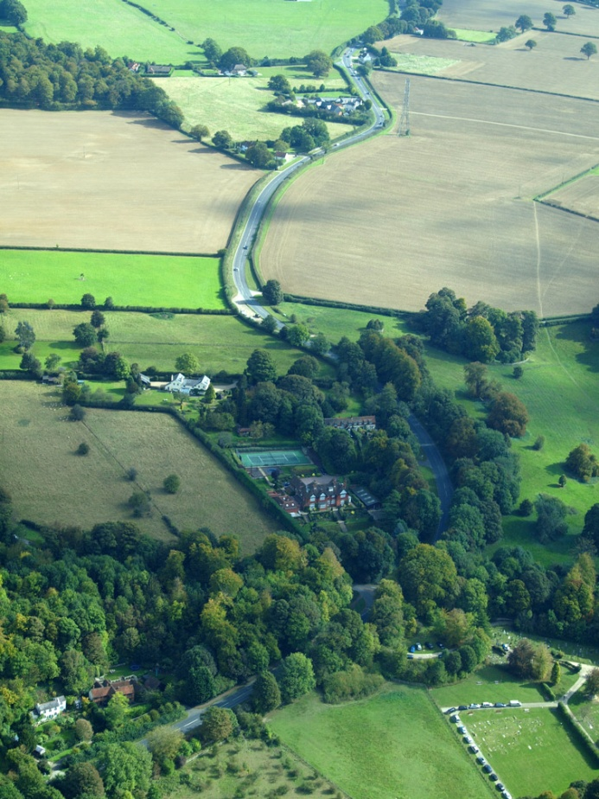
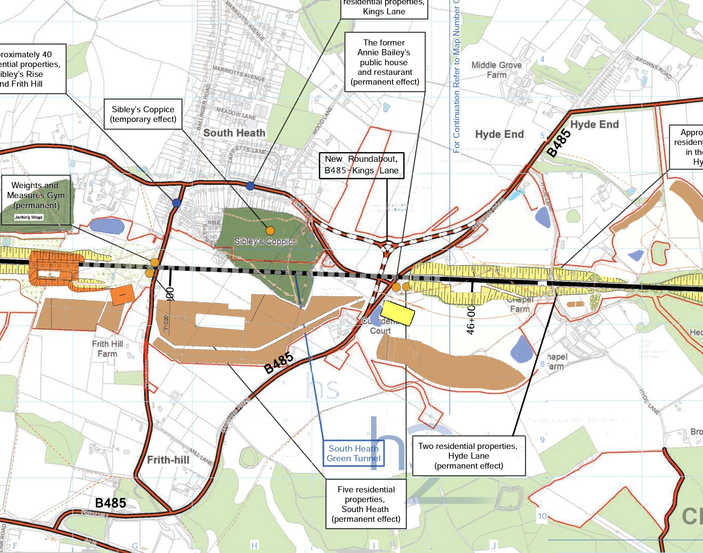
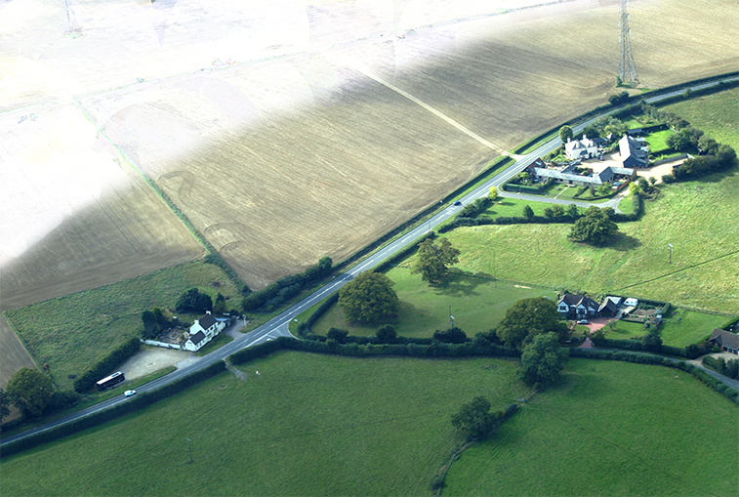
B485 (Chesham – Gt. Missenden Road)

Slide 20
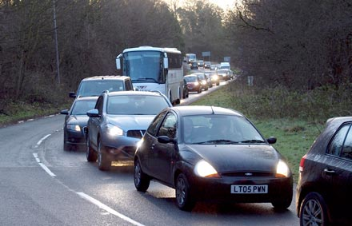
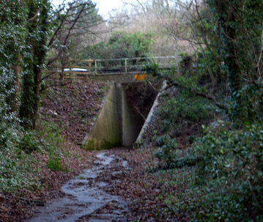

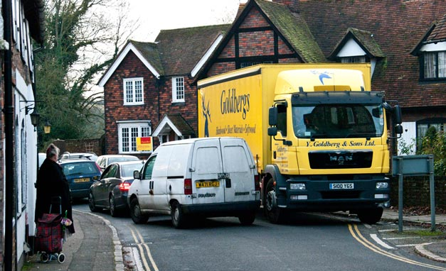
B485 (Chesham – Gt. Missenden Road)
← Peak hour tailbacks at junction with
A413 already vastly exceed the predictions
made in the ES.
Footpath from Frith Hill to Gt.
Missenden, passing under the
B484 & A413
The B485 passes through Chesham
Old Town. Requests for a ban on HGVs
have not been successful.

Slide 21
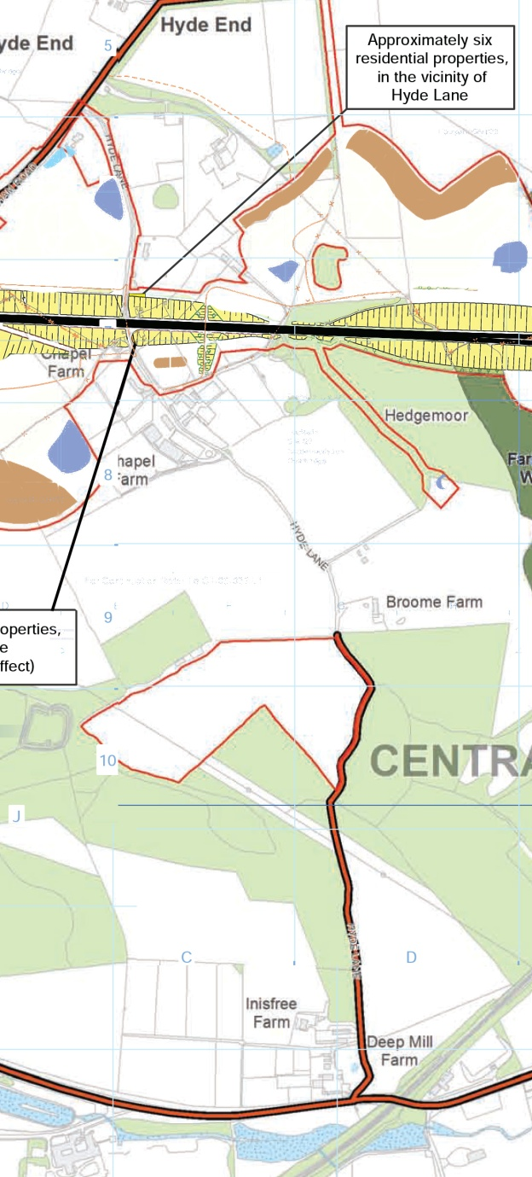
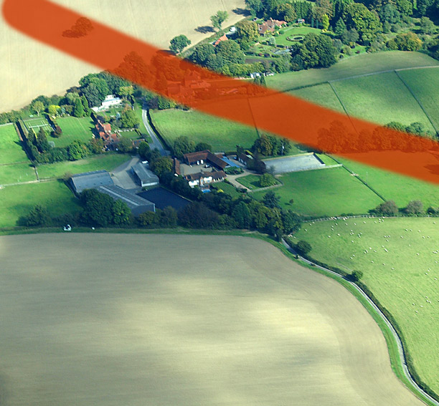
Hyde Lane
A quiet single track road connecting
the B485 and A413 – to be closed for a
year while a new bridge is constructed.
The lower access is to an area of ‘offset’
planting

Slide 22
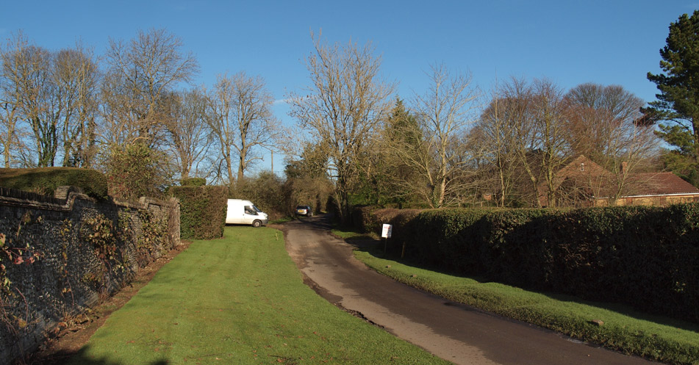
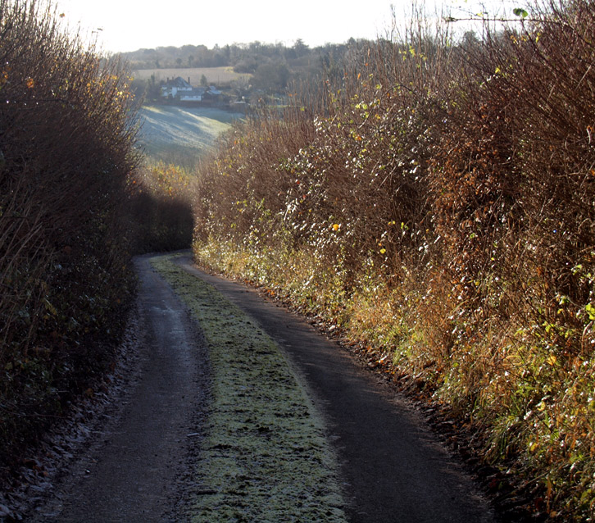
Hyde Lane
← The White Van
marks the crossing
point
This section is used to access ‘offset’ →
planting. No amount of offsetting would
compensate for any damage to these
hedgerows.
Hyde Lane joins the A413 on the bend at
Deep Mill bridge – a known accident
blackspot.

Slide 23
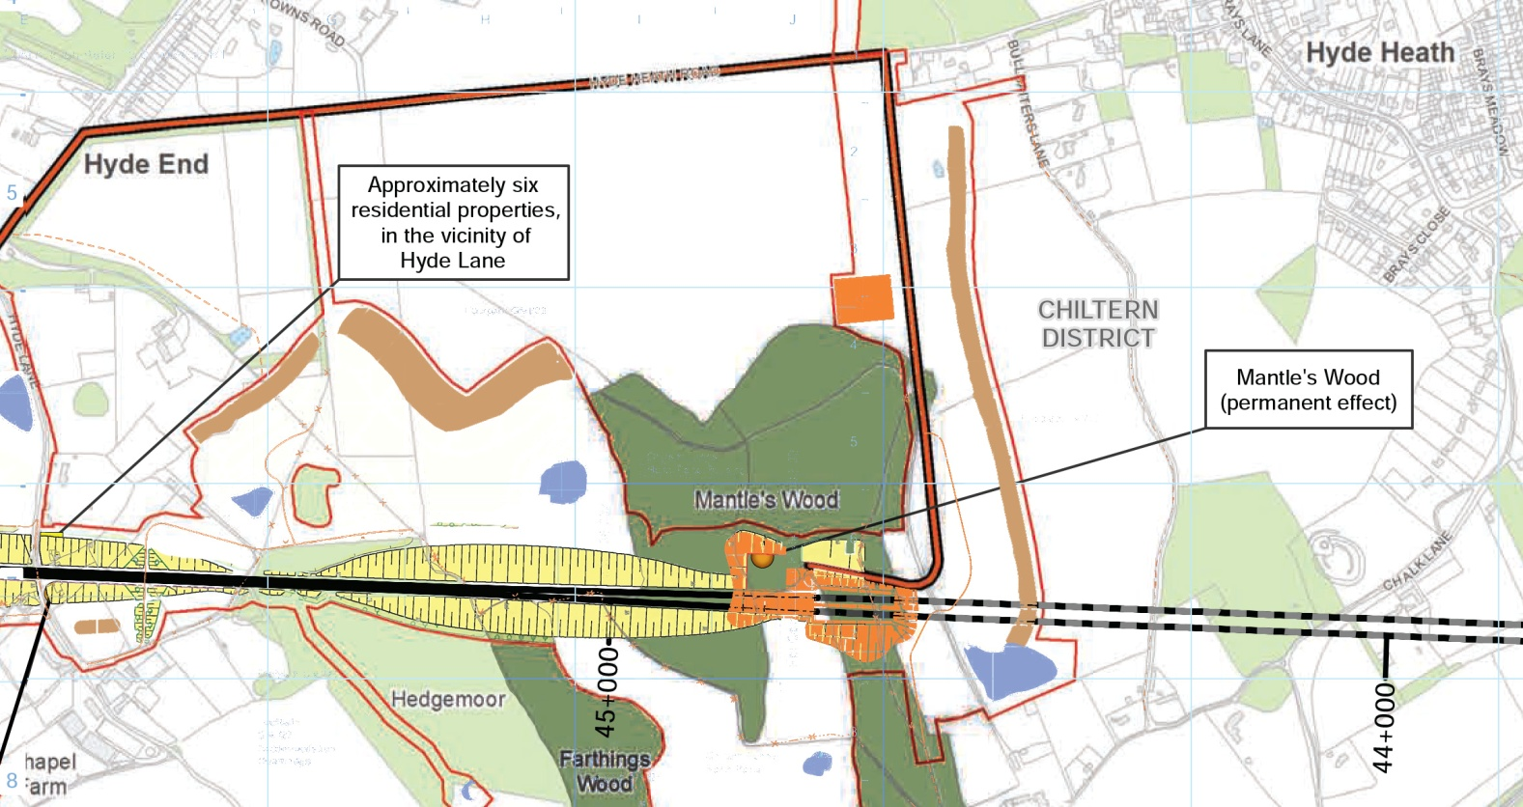
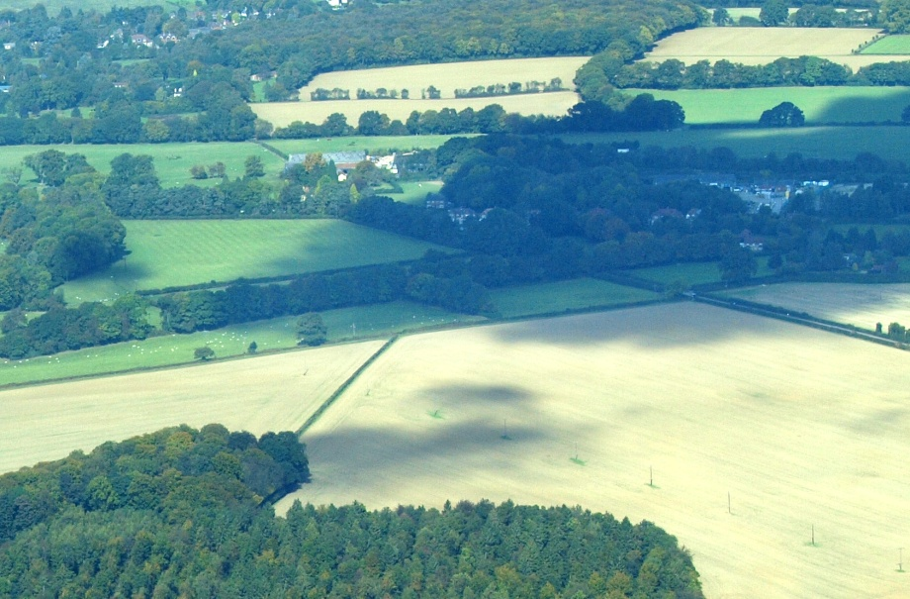
Hyde Heath Road
Hyde Heath Road is the main route
out of the village towards Aylesbury
and Wendover (via B485 & A413 )
Mantle’s Wood (foreground) and
Hyde End/B485 →
Hyde Heath 
Road

Slide 24
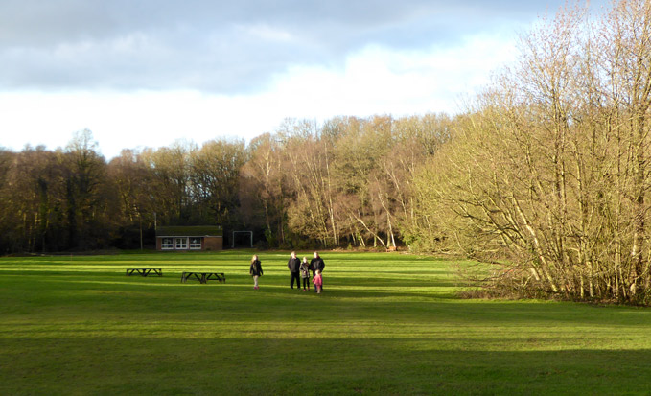
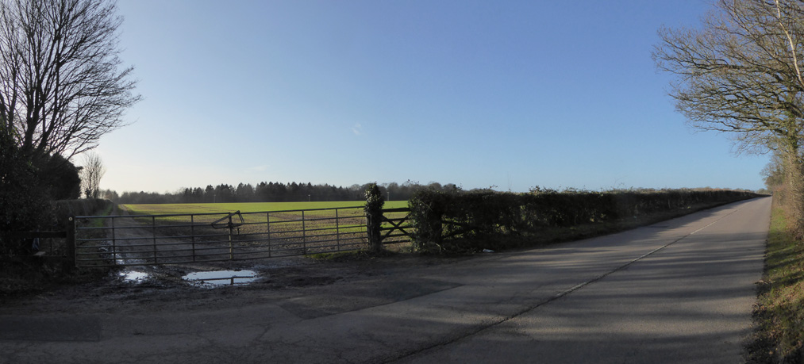
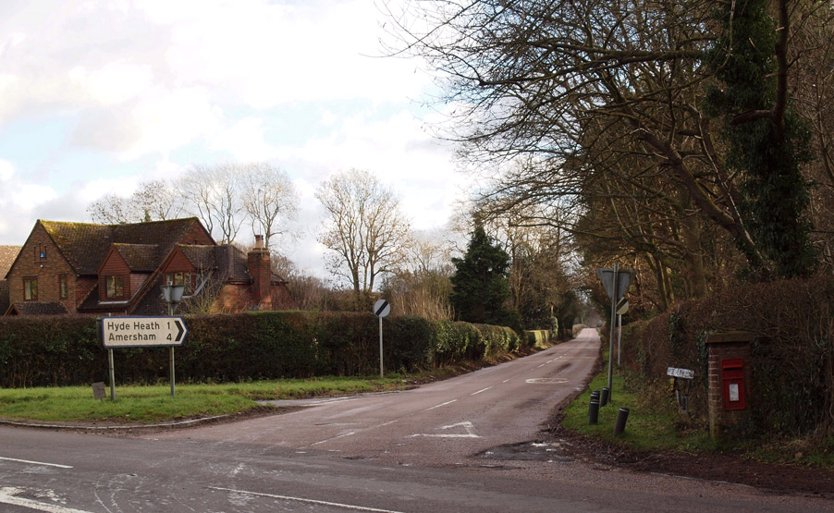
Hyde Heath Road
This is the main construction route to the
Chiltern’s Tunnel North Portal, and the permanent emergency access route.
Hyde Heath Common
End of the farm track ↑
to Mantles Wood
Junction with B485 at →
Hyde End

Slide 25
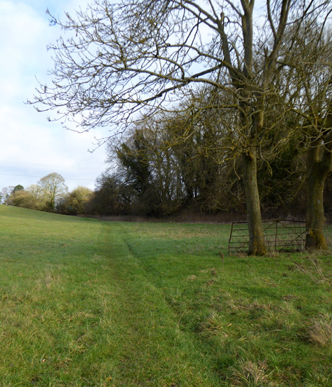


South Heath – N. Portal Access
Proposed road to access the trace between
South Heath and the Wendover viaduct.
The new road follows footpath GMI/12/1,
but could join the A413 at the “Link Road” roundabout, if this reduced congestion.

Slide 26


Chilterns N. Portal Access
The HS2 route to the North Portal is a 4½ mile
diversion to reach a point just over ½ a mile
from the A413.
The proposed alternative does not pass through
Mantles Wood, and substantially reduces traffic
on Frith Hill and the B485.

Slide 27




Chilterns N. Portal Access
The “Existing farm access track”
becomes a footpath on entering
the wood. →
The HS2 proposal necessitates the
construction of a new road through
the wood, descending in a cutting
to reach the track level.
← A bridge over the Chiltern Line at this point would give access
to the field adjacent to the portal; a new road could be constructed
following the edge of the wood, and screened by a belt of trees,
or the new planting
proposed by HS2.

